Slide 1
Welcome!
NOTE:
Using this PPT to present your new SPBP to all staff and parents/families, fulfills the criteria in Critical Element 2B of your School-wide Positive Behavior Plan (SPBP). This is a quick and easy way to accomplish these tasks!
DIRECTIONS:
1. Review this PPT before presenting; all orange font will need to be replaced by your school’s individual information. Replace all orange font with information directly from your SPBP for this year.
2. Each slide has notes that your can (literally) just print up and read when your show each slide.
3. Keep a sign-in sheet for your staff presentation and your stakeholder’s presentation. Keep sign-in sheets in your SPBP Binder for 2 years.
4. Document the dates completed in your next SPBP. You’re done!
(DELETE or skip this slide when presenting!)

Slide 2
WELCOME to the PBIS Kick Off!
An introduction to PBIS and the School-wide Positive
Behavior Plan (SPBP)
at our school
Notes:
Welcome all – today we have a short PowerPoint to introduce or remind us all about Positive Behavior Interventions and supports, or PBIS.

Slide 3
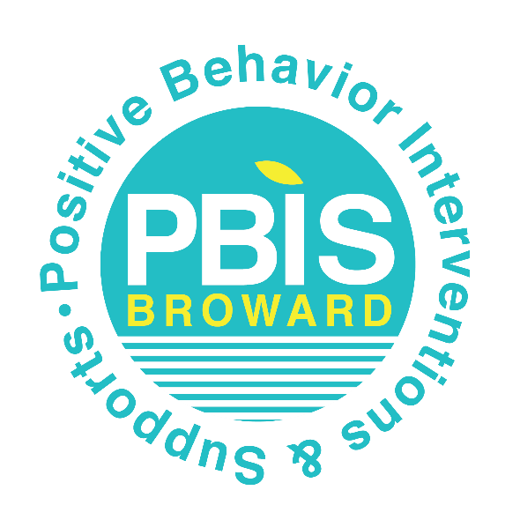
We are a PBIS school!
Positive Behavior Interventions & Supports is a school-wide behavior system
that creates a safer and more effective learning environment.
Notes:
PBIS is a process for creating a safer and more effective school. The process focuses on improving our school’s ability to teach and support positive behavior for all students. We know that when good behavior and good teaching come together, our students will excel in learning.

Slide 4
We are a PBIS school!
What does this mean?!
PBIS focuses on improving our school’s ability to teach and support positive skills and behavior for all students.
By helping students practice good behavior, we will build a strong community in which all students can succeed and grow.
Notes:
PBIS is not a program, but a solid foundation for using school data to create a school-wide behavior plan for ALL students. It is a proactive system that focuses on preventing misbehaviors from even occurring by teaching positive skills to all students.

Slide 5
How is PBIS implemented?
Tier 3 PBIS: Intensive behavior support for a few students
Tier 2 PBIS: Targeted behavior support for some struggling students
Tier 1 PBIS: High quality behavior curriculum for ALL students
Notes:
PBIS is provided for ALL students by levels or tiers, based on student need. Students who struggle with behavior are provided with more support.

Slide 6
How is PBIS implemented?
PBIS uses:
Effective Instructional Strategies
We believe that school-wide expectations and rules
should be taught in the same way we teach academics-
through teacher-lead lesson plans
Notes:
We believe that school-wide expectations and rules should be taught in the same way we teach academics – through lesson plans. Behavior lesson plans are overtly taught to all students. These lesson plans are taught by teachers throughout the year, not in one assembly or just at the beginning of the year!

Slide 7
In our school….
Our school-wide Expectations are:
Insert your Expectation #1
Insert your Expectation #2
Insert your Expectation #3
Insert your Expectation #4
Insert your Expectation # 5
Notes:
All students are taught our school-wide Expectations through specific behavior lesson plans which we developed based on our own school data. These expectations pertain to everyone on campus: students, staff, parents and visitors. The more we all model these expectations, the better students learn them!
(if you have a school expectations poster, you can add it to this slide too!)

Slide 8
In our school….
Some of our rules for specific locations are:
Cafeteria
Hallways
Insert your Rule #1
Insert your Rule #2
Insert your Rule #3
Insert your Rule #4
Insert your Rule # 5
Insert your Rule #1
Insert your Rule #2
Insert your Rule #3
Insert your Rule #4
Insert your Rule # 5
Notes:
All students are also taught rules for specific common areas through behavior lesson plans. These rules are for students only.

Slide 9
How is PBIS implemented?
PBIS uses:
Positive Reinforcement Strategies
We believe that students learn best when they
are reinforced for demonstrating positive behavior.
“Thank you for picking up that garbage. That is being responsible!”
Notes:
We believe that students learn best when reinforced for demonstrating positive behaviors. Consequences can temporarily stop or decrease behaviors, but they do not teach the skills that students need to be successful. Reinforcing positive skills increases the chance that those behaviors will occur again in the future. We use the language of our school-wide expectations when reinforcing our students.

Slide 10
In our school….
Some of our school-wide rewards include:
Insert example of student reward
Insert example of student reward
Insert example of student reward
Insert example of student reward
Notes:
All students have the opportunity to receive these rewards through demonstrating positive behaviors such as following the school-wide expectations and the location-specific rules.

Slide 11
How is PBIS implemented?
PBIS uses:
Consistent Correction
We believe that students benefit from a consistent
and predictable environment.
“Please walk on the right side of the hallway; that follows our rules and makes everyone safe.”
Notes:
All staff correct the same misbehaviors across all students with the same language. Staff-managed and Administration-managed behaviors are specified and defined in our School-wide Positive Behavior Plan.

Slide 12
In our school….
We all correct misbehavior with the same Consequences.
Staff-managed Misbehavior Consequences:
Insert consequence option 1
Insert consequence option 2
Insert consequence option 3
Insert consequence option 4
Insert consequence option 5
Notes:
All staff are taught the difference between staff-managed and office-managed behavior levels. School consequences are assigned based on our Discipline flow chart. This provides a consistency in discipline and language across our school.

Slide 13
How is PBIS implemented?
PBIS uses:
Logical Consequences
We believe that students need to be
in their classrooms to learn
“Let’s talk at lunch today about how you can be more successful in our classroom.”
Notes:
We believe that students need to be in their classrooms to learn. Our consequences are designed to minimize the demonstration of repeated occurrences of misbehavior while focusing on non-exclusionary consequences. This means that we want students in our classrooms, learning!

Slide 14
In our school….
Office Discipline Referrals only occur for specific serious misbehaviors, such as:
Insert example of ODR misbehavior
Insert example of ODR misbehavior
Insert example of ODR misbehavior
Insert example of ODR misbehavior
Insert example of ODR misbehavior
Notes:
Students and staff are taught which specific misbehaviors will be referred to the office for the Administrators to manage. By doing this, students are only out of the classroom for these serious misbehaviors.

Slide 15
What are the outcomes of PBIS?
When implemented consistently and effectively, PBIS:
Reduces disruptive behaviors in school
Creates a highly positive climate across campus
Maintains a least restrictive environment for all students
Creates a consistent discipline and reinforcement language for all staff
Addresses disproportionality issues
Improves attendance for students – and staff!
Notes:
National research shows that when PBIS is implemented consistently and effectively, it has many positive outcomes for students, schools and staff such as: (read bullet points)

Slide 16
We are a PBIS school!
School-wide expectations are posted across the campus
Specific rules are posted in high problem areas such as the cafeteria
All classrooms have expectations and rules posted
Behavior lesson plans are overtly taught to all students
Discipline process is followed consistently by all staff for all students
Positive staff-to-student interactions outweigh negative interactions
Notes:
In our school, you will see expectations and rules posted, you will hear behavior lesson plans being taught to all students, and you will feel the positive climate of a PBIS school.

Slide 17
In our school…
These are the members of our PBIS team:
Insert team member name
Insert team member name
Insert team member name
Insert team member name
Insert team member name
Insert team member name
Notes:
Our PBIS team meets regularly to review behavior data and modify our plan as needed. If you would like to become a member of our team, please see the school Administrators.

Slide 18
Where can you find our PBIS?
Positive Behavior
Interventions & Support
School-wide Positive
Behavior Plan
School Improvement
Plan
PBIS
SPBP
SIP
10 Critical Elements
Notes:
Our PBIS implementation is documented in the School-wide Positive Behavior Plan. This is a part of our School Improvement Plan. PBIS has 10 critical elements and they can all be found in our SPBP. If you are not sure where the SPBP is located, ask us!

Slide 19
Questions?
For more information,
Call:
The School Climate & Discipline Department
(formerly Diversity, Prevention & Intervention Dept.)
Lauderdale Manors Resource Center
(754) 321-1655
Check out our PBIS Sharepoint Site:
https://browardcountyschools.sharepoint.com/sites/DPI6Strands/strand6/SitePages/PBIS.aspx
Contact:
Desiree.Montalvo@browardschools.com
Tyyne.Hogan@browardschools.com
Notes:
Our school has district support in completing the School-wide Positive Behavior Plan and implementing PBIS. We’d love to hear your feedback and input! Are there any questions we can answer now?

